Slide 1
primer to python for astronomers
Imran s Hasan

Slide 2
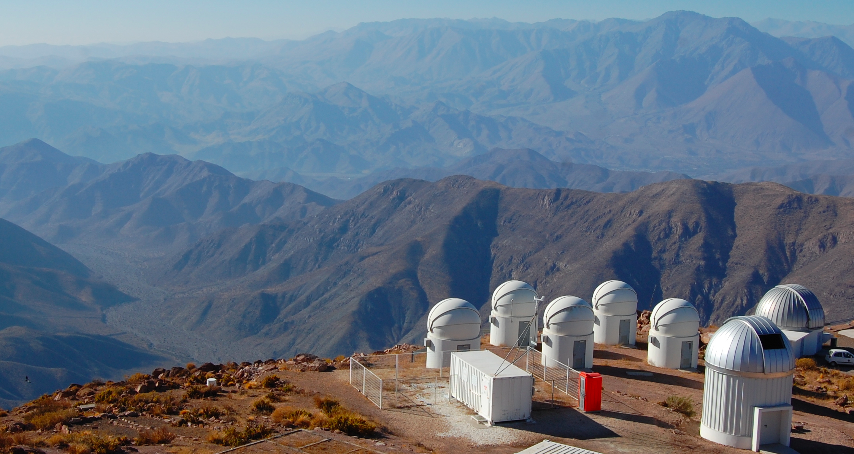
Small telescopes
Organize observing plans
Process/Distribute/Archive data
Develop & Maintain pipelines
Long term behavior of black holes
Share data with the world

Slide 3
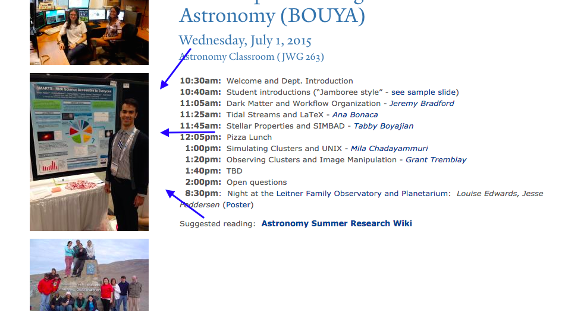
Cool story bro
You may also recognize me as that cool guy
In the picture for the boot camp website

Slide 4
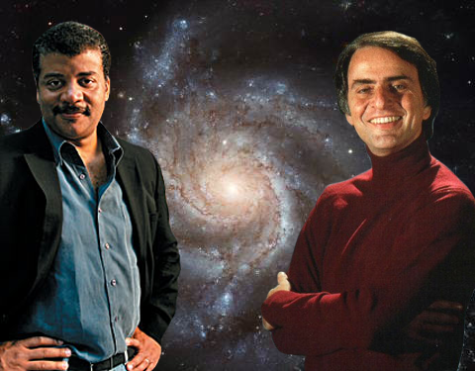
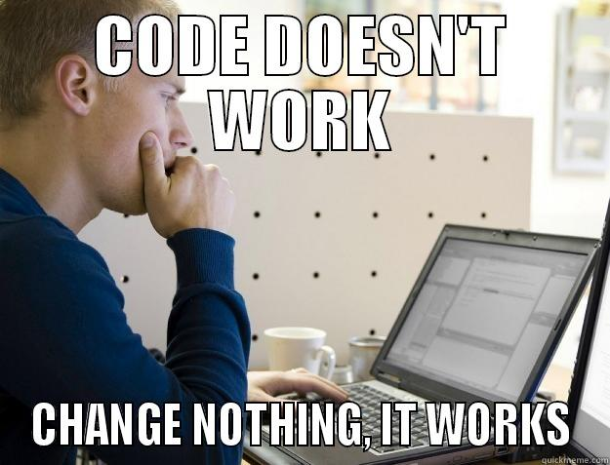
I’m an astronomer…
What I think I do
What I really do

Slide 5
Coding in astronomy
Almost all professional astronomers code! Our data are almost always digital (detector data, simulations)
Most widely used languages today are probably Python, IDL, and Fortran
A lot of legacy code is written in older languages like Fortran, C, C++ from back in the day
The community is brimming with collaborative projects. Chances are you will use one this summer

Slide 6
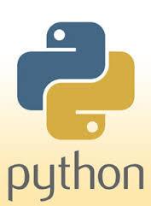
Why use python?
Python is free, other languages are not
It is pretty easy to pick up
It has a large community (inside and outside of Astronomy)
It ‘plays well’ with other languages-especially ones we use
If you are having programming troubles, chances are someone has had them previously and figured them out
Many super useful libraries
If you can’t find a library to suit your needs, you can make roll your own!

Slide 7
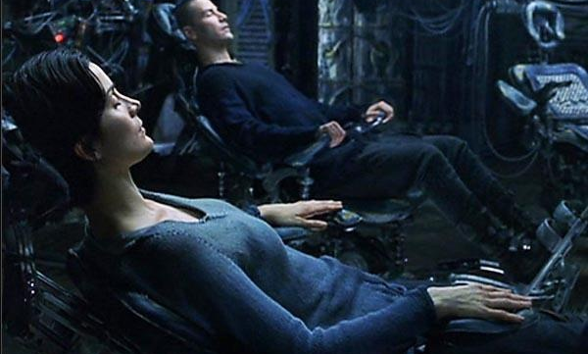
Becoming a pythonista
I wish I could download everything
I know directly into your brain
A la the matrix, but I can’t ☹
I can help you get started

Slide 8
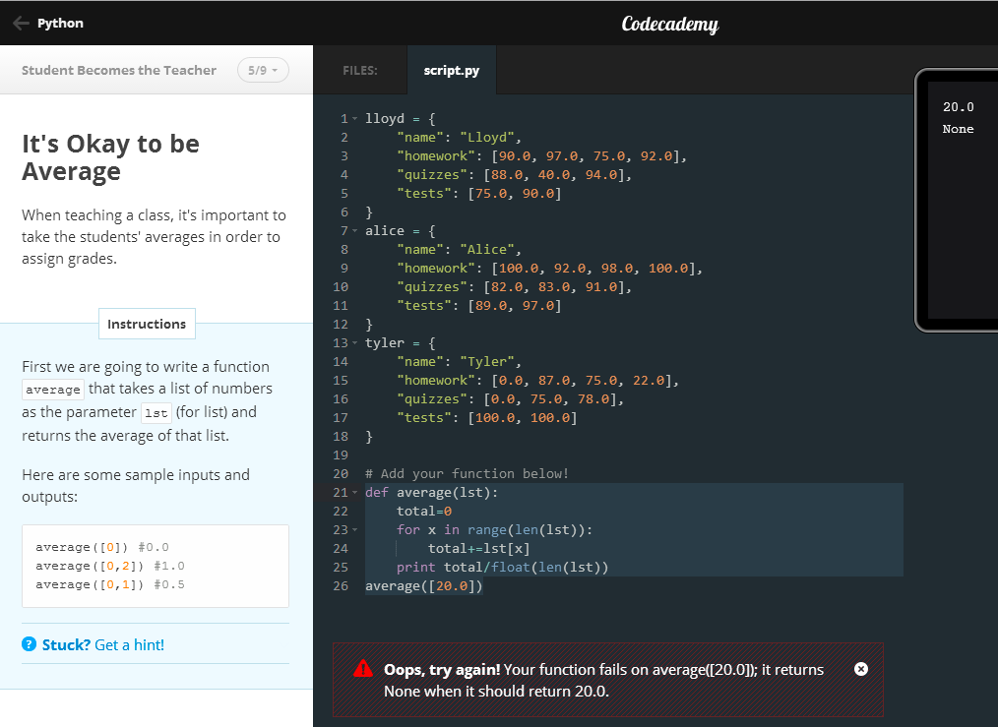
Codecademy.com
Learn to use python effectively
Learn to write programs line by line
Learn good programming practices
Helpful feedback, and forums if you get stuck

